Slide 1


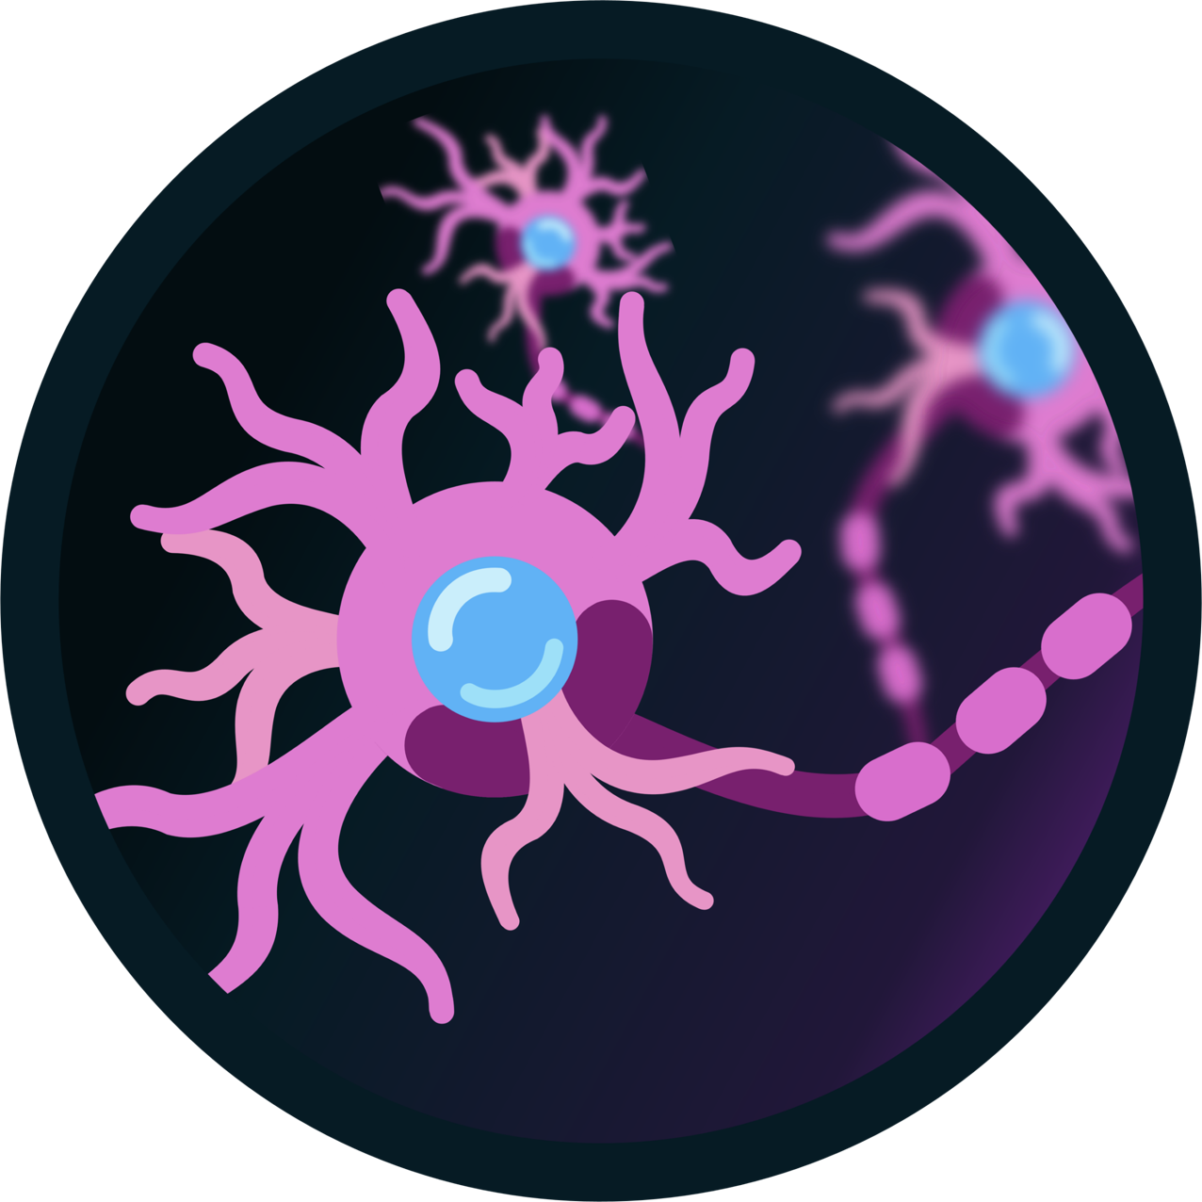

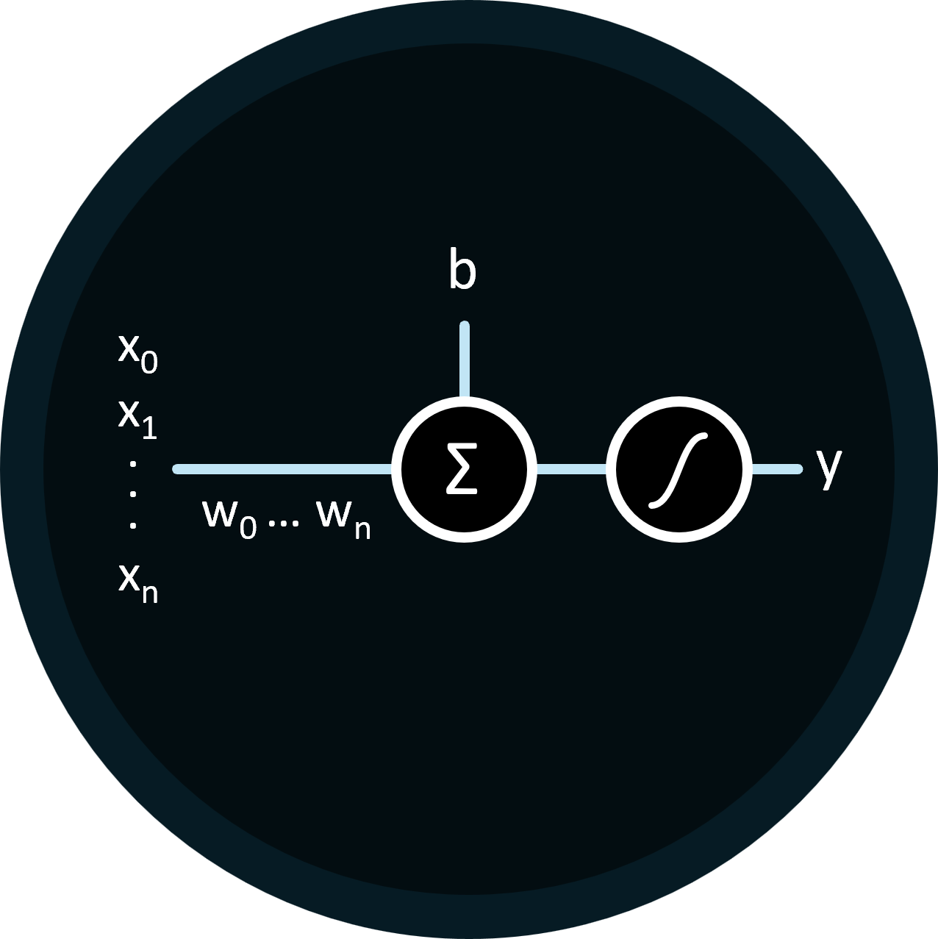

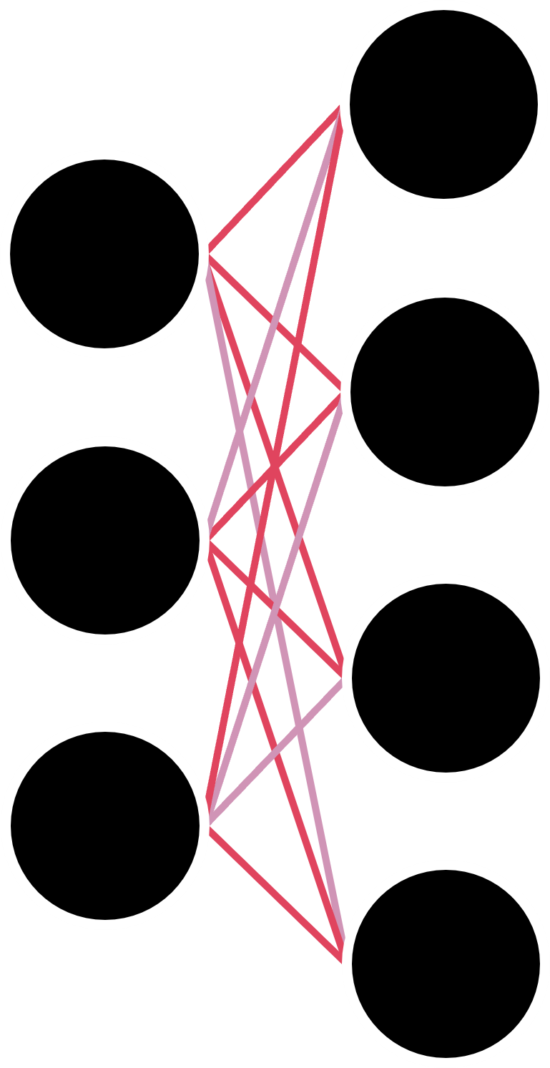


Perceptrons: The First Trainable Neural Networks
Christopher, Harvey, Sean, Nathan
Introduction -
From Biological to Artificial
Humble Beginnings -
The Single Layer Perceptron
Learning from Mistakes -
Backpropagation
Introducing Complexity -
The Multi-Layer Perceptron
The perceptron model is trained by tweaking the weights such that for a given input we get the expected output. The algorithm used to do so is called backpropagation.
For a given input, the model may produce some incorrect output.
…
Biological brains are made up of many individual neurons which share inhibitory and excitatory connections with each other. An inhibitory connection reduces a neuron's likelihood of activation, while an excitatory connection increases it. When a neuron is sufficiently excited, it will fire an activation signal which propagates through said connections. It should be noted that every neuron has its own activation threshold.
At the heart of bringing simulated biological neurons to life was the perceptron: a computerized model based on the brain that has the ability to learn.
In this model, the perceptron represents a single neuron. The inputs (x_{i}) to the perceptron can be seen as other neurons, represented by continuous values that indicate their level of excitement—the higher the value, the more excited the neuron; the lower the value, the less excited it is.
The inhibitory and excitatory connections to said inputs are represented by weights (w_{i}) which are also continuous values. A negative value represents an inhibitory connection whilst a positive value is an excitatory connection. These weight values are multiplied with their respective input providing a value that represents the contribution that input makes to the final activation state of the perceptron.
A constant bias (b) term is added to represent the activation threshold of the perceptron.
By summing up each input’s contribution with the bias, the final activation state of the perceptron can be found. This value is then passed through an activation function to introduce non-linearity, allowing the perceptron to learn more complex patterns.
The brain is comprised of billions of neurons, a far larger amount than a single perceptron. The Multi-Layer Perceptron model extends this by introducing hidden layers comprising of multiple perceptrons.
These hidden layers allow the model to learn non-linear decision boundaries whereas a Single-Layer Perceptron model can only learn linear decision boundaries (problems where data can be separated by a straight line).
If computers could artificially simulate biological neurons and the information represented by their connections, then maybe computers could learn to replicate human intelligence as well.
1943 McCulloch and Pitts: Artificial Neurons
1957 Frank Rosenblatt: The Perceptron Model
Endless Possibilities -
Deep Machine Learning

Slide 2
Perceptrons: The First Trainable Neural Networks
Christopher, Harvey, Sean, Nathan
1
Introduction -
From Biological to Artificial
Biological brains are made up of many individual neurons which share inhibitory and excitatory connections with each other. An inhibitory connection reduces a neuron's likelihood of activation, while an excitatory connection increases it. When a neuron is sufficiently excited, it will fire an activation signal which propagates through said connections. It should be noted that every neuron has its own activation threshold.
If computers could artificially simulate biological neurons and the information represented by their connections, then maybe computers could learn to replicate human intelligence as well.
1943 McCulloch and Pitts: Artificial Neurons

Slide 3

Green, Red Yellow
Perceptrons: The First Trainable Neural Networks
Christopher, Harvey, Sean, Nathan
1
Introduction -
From Biological to Artificial
Learning from Mistakes -
Backpropagation
Humble Beginnings -
The Single Layer Perceptron
Introducing Complexity -
The Multi-Layer Perceptron
v
Endless Possibilities -
Deep Machine Learning

Slide 4
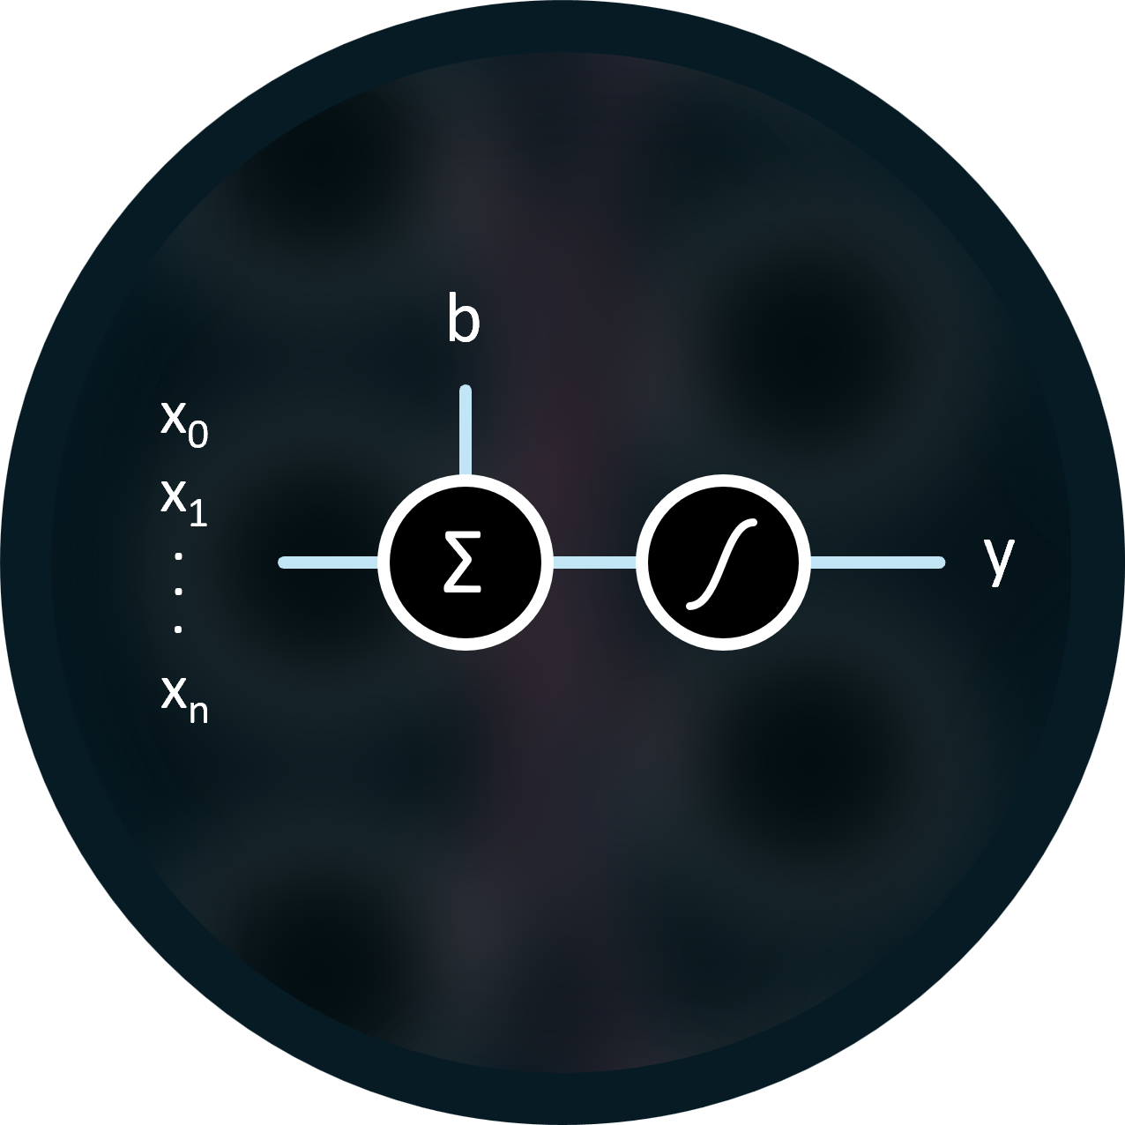




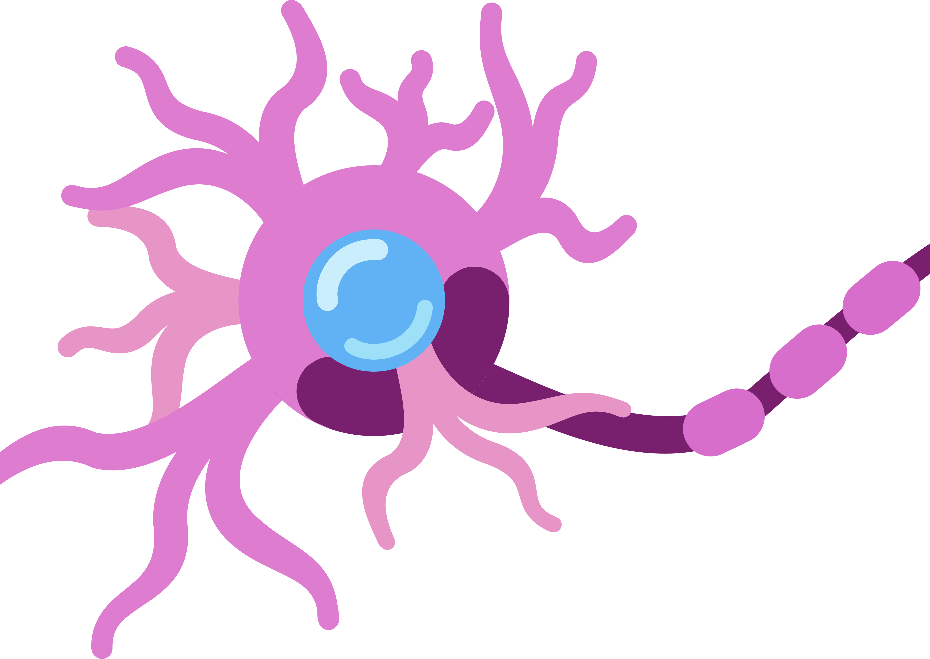
x₀
b
x₁
.
Σ
y
.
.
x_{n}
x₀
b
x₁
.
Σ
y
.
w₀ … w_{n}
.
x_{n}

